Slide 1
RBFT: Redundant Byzantine Fault Tolerance Pierre-Louis Aublin, Sonia Ben Mokhtar, Vivien Quema Grenoble University, CNRS – LIRIS, Grenoble INP
Presenters: Rohan Sogani, Utkarsh Opalkar
ECS 265 Fall 2019 Paper Presentation

Slide 2
Agenda
Motivation
RBFT Overview
Detailed Protocol Steps
Implementation
Performance Evaluation
Conclusion

Slide 3
Motivation
Robust BFT Protocols
Achieve good performance when faults occur
Prime, Aardvark, and Spinning claim to be Robust, but they are not!
Reason: They rely on dedicated replica called primary to order request

Slide 4

Drawbacks of Aardvark
Regular View Change
No throughput during view change
Not a reliable yardstick for comparison
Replicas expect a min. throughput from Primary
Replicas also monitor ordering messages
What if primary is smartly malicious?
V1
V2
V3
. .

Slide 5
RBFT Protocol

Slide 6
RBFT Overview
Requires 3f + 1 nodes
Each node runs f + 1 instances in parallel
Each instance orders request, like PBFT
At most 1 primary per node
For f = 1
1 Master Instance
1 Backup Instance
Only requests ordered by Master are executed
Backup orders requests to monitor Master
Leverages Multi-Core Architecture
Same Code-Base as Aardvark
Clients
Node 0
Node 1
Node 2
Node 3
Master
Primary
Replica
Replica
Replica
Backup
Replica
Primary
Replica
Replica

Slide 7
Detailed Protocol Steps
6 Step process
REQUEST
PROPOGATE
PRE-PREPARE
PREPARE
COMMIT
REPLY

Slide 8

Step 1: REQUEST
Client sends < < REQUEST, o, rid, c >$σ_{c}$, c >$μ_{c}$
Node i verifies MAC if valid then verifies signature if invalid blacklist c
If request already processed, resend reply
1. REQUEST
C
0
1
2
3

Slide 9

Step 2: PROPAGATE
Node sends < PROPAGATE, <REQUEST, o, s, c >$σ_{c}$, i>$μ_{i}$
Request is given to other protocol instances only if a node receives f + 1 PROPAGATE
1. REQUEST
2. PROPAGATE
C
0
1
2
3

Slide 10

Step 3, 4, & 5: 3 Phase Commit in Parallel
Primary p of an instance sends < PRE-PREPARE, v, n, c, rid, d >$μ_{p}$
Replica nodes send PREPARE if f + 1 copies of request
After receiving 2f PREPARE, a replica sends < COMMIT, v, n, d, r>$μ_{r}$
1. REQUEST
2. PROPAGATE
COMMIT
COMMIT
PRE-PREPARE
PREPARE
COMMIT
PRE-PREPARE
PREPARE
PRE-PREPARE
PREPARE
C
0
1
2
3

Slide 11

Step 6: Execute
Request Executed after a node receives an ordered request from a replica of a master instance
Node i sends < REPLY, u, i>$μ_{i, c}$. u is the result.
1. REQUEST
2. PROPAGATE
3. PRE-PREPARE
4. PREPARE
5. COMMIT
6. EXECUTE
C
0
1
2
3

Slide 12

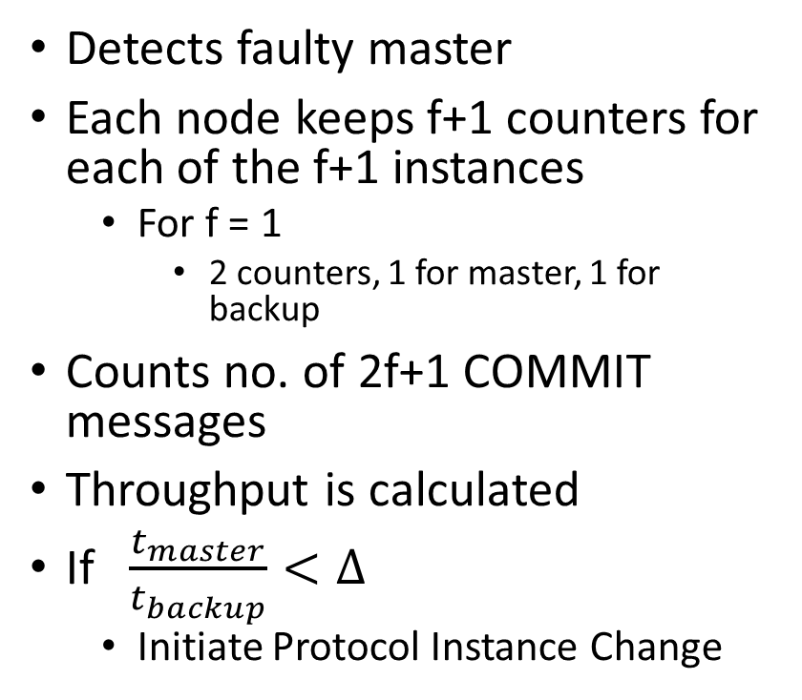

Monitoring Mechanism: Throughput
Detects faulty master
Each node keeps f+1 counters for each of the f+1 instances
For f = 1
2 counters, 1 for master, 1 for backup
Counts no. of 2f+1 COMMIT messages
Throughput is calculated
If $\frac{t_{master}}{t_{backup}}<∆$
Initiate Protocol Instance Change
NODE
Counter
Counter
master
backup
$$t_{master}$$
$$t_{backup}$$
Periodic checks
Monitoring Unit

Slide 13

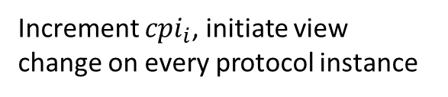

Protocol Instance Change Mechanism
Each node i keeps a counter ${cpi}_{i}$, uniquely identifies an instance change message
If detects slow performance, Sends < INSTANCE_CHANGE, ${cpi}_{i}$, i>$μ_{i}$
Increment ${cpi}_{i}$, initiate view change on every protocol instance
Send Instance Change
If ${cpi}_{i}≥{cpi}_{j} \&\& slow performance$
Master p
0
Send Instance Change
Backup p
1
Detects
2
2f + 1
3
Send Instance Change
Notes:
RBFT replaces primary on each node during protocol instance change as is at most 1 primary per node

Slide 14
Implementation

Slide 15
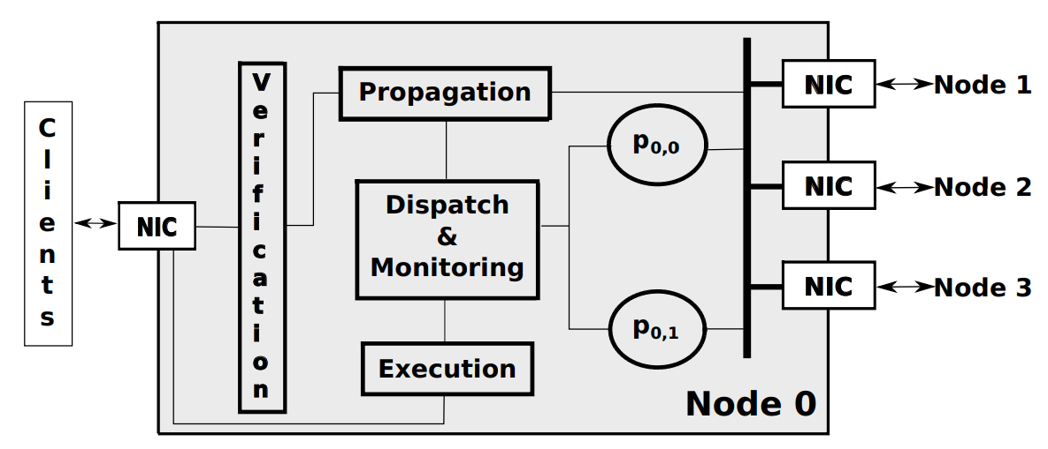
Implementation
A client sends requests to all nodes
Notes:
Explain diagram > NIC
8 cores used
These are threads running parallelly

Slide 16
Implementation
Verification module authenticates the incoming messages
Notes:
MAC > discard if invalid > Signature > blacklist if invalid

Slide 17
Implementation
Messages received are PROPOGATED to every other node
Notes:
So that every node receives the request eventually > waits for reply

Slide 18
Implementation
PROPOGATION module waits for f+1 PROPOGATE messages
Notes:
Assume there are malicious nodes present > in this case f=1 > PROPOGATION waits to receive only f+1 PROPOGATE from others

Slide 19
Implementation
PROPOGATION module waits for f+1 PROPOGATE messages
Notes:
request is now ready to be handed to f+1 protocol instances through the D&M

Slide 20
Implementation
Message is dispatched to all f+1 BFT instances running parallelly
Notes:
D&M passes on the msg to all f+1 BFT instances > all instances run BFT consensus in parallel, to count 2f+1 COMMIT msgs for the said request

Slide 21
Implementation
Performance of each BFT instance is monitored by counting every COMMIT stage reached
Notes:
after 2f+1 COMMIT msgs for said req; REPLY msg is sent back to D&M where it logs that consensus has been reached
Monitoring will periodically (1 sec) check ratio of (consensus was reached on how many requests for all instances)
If MASTER instance is not better in above comparison, instance CHANGE is initiated

Slide 22
Implementation
Ordered requests coming from the master protocol instance is sent to the Execution module
Notes:
As for execution, only the request proposed by the primary of the master instance is sent to EXECUTION denoted by green

Slide 23
Implementation
Reply is sent back to client after execution

Slide 24
Performance Evaluation

Slide 25
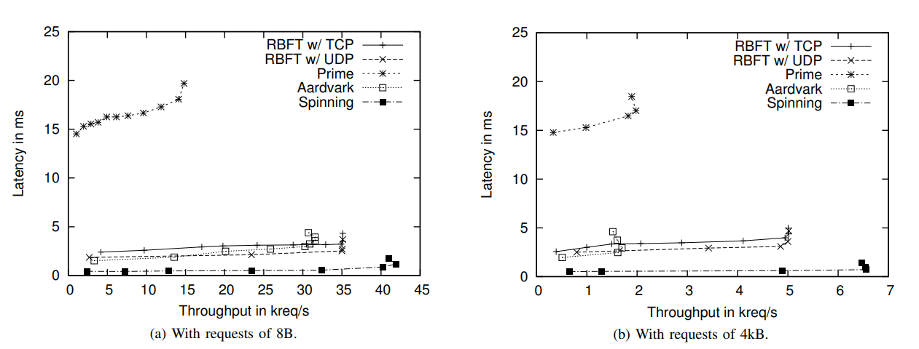
Performance Evaluation – (I) Fault Free
Latency vs Throughput for robust BFT protocols
Notes:
Spinning provides highest coz only MAC
Aardvark slightly low coz, regular view changes
When regular VC was turned off -> Aadrvard == RBFT
Prime relies only on SIGNATURES, hence WORST

Slide 26
Performance Evaluation– (II) Worst Attack 1
CONDITIONS –
f faulty nodes and all clients are faulty
primary of the master protocol instance is correct
AIM –
To cause max decrease in performance of the master instance to induce a protocol instance change.
RESULT –
Throughput degradation of RBFT is
below 2.2% for static load
null with the dynamic load

Slide 27
Performance Evaluation– (III) Worst Attack 2
CONDITIONS –
f faulty nodes collude with faulty clients(all are faulty)
primary of the master protocol instance is also faulty
AIM –
To decrease performance of the backup protocol instances so that faulty primary of master protocol instance can delay requests without being detected
RESULT –
maximum throughput loss is below 3%

Slide 28
Performance Evaluation– (IV) Unfair Primary
CONDITIONS –
Primary of the master protocol instance is unfair (malicious)
AIM –
To process the requests of a given client less frequently than for the other clients
RESULT –
Biased Primary gets replaced as RBFT does not tolerate latency of a client request beyond a given max latency threshold and invokes change of master instance.

Slide 29
Conclusion
State of art “Robust BFT” protocols are not Robust.
RBFT leverages multicore architecture.
Runs several instances of a BFT protocol in parallel.
Monitors and compares performance of primary.
Maximum throughput degradation during attacks is 3%.

Slide 30
QUESTIONS?

Slide 31
THANK YOU!

